Slide 1

Mental Health Learning Hub
2019/20

Slide 2
KEY FEATURES
Cross phase membership – primary, secondary, special
A wider network of members and attendees, including Camden Learning Health and Well-being team, CAMHS representatives
AIMS 2019/20
Develop www.thinkingcards.org.uk site and related app
Trial primary thinking cards in schools
Develop cross-phase resources on approaches to managing anxiety

Slide 3
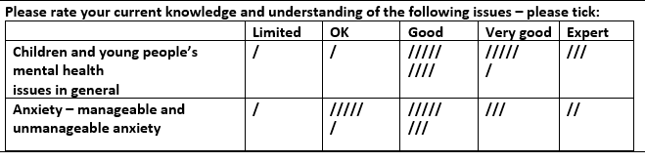
Baseline - October
What did members want to get from the hub this year?
Sharing and developing resources,
learning from experts and each other,
developing links with other schools, settings and professionals

Slide 4
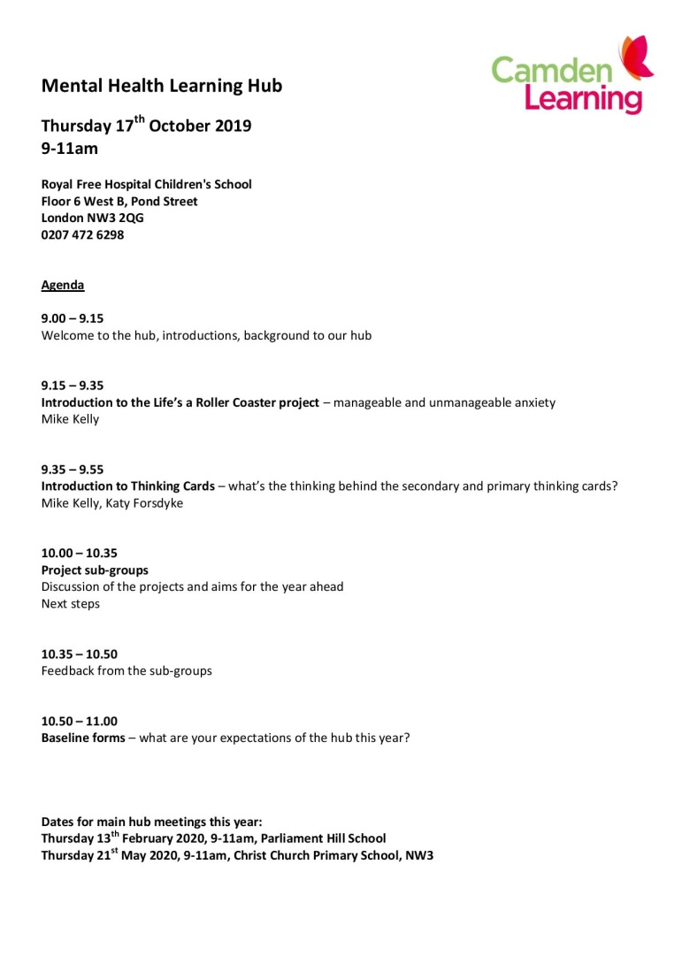
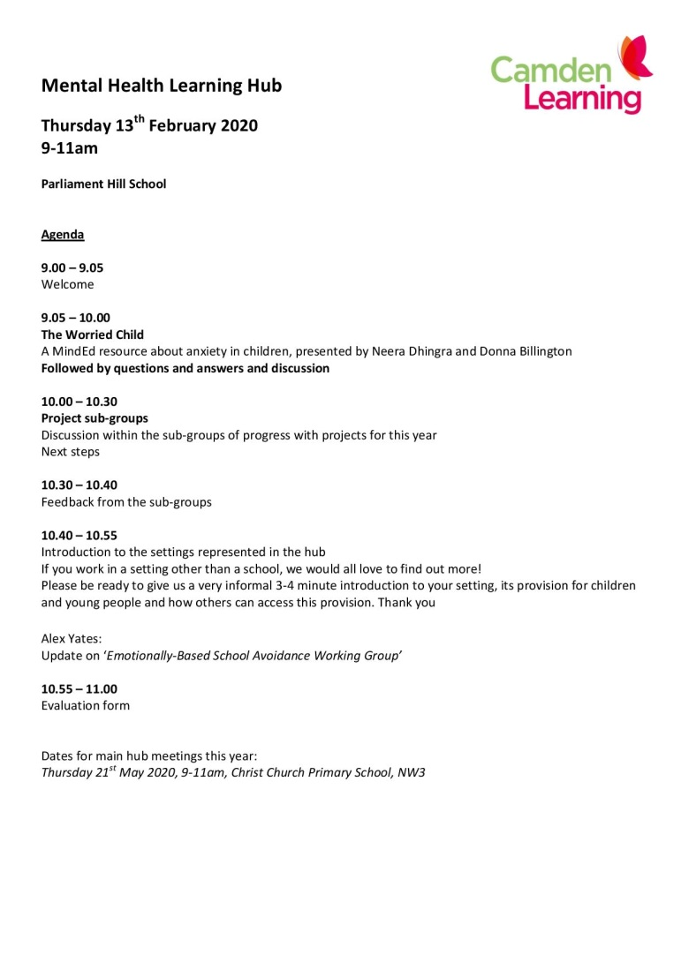
Core Meetings
Expert speakers or presentations to make the focus on learning

Slide 5

‘Life’s a Rollercoaster’
'The Roller Coaster' project is designed to help students think about when anxiety has reached a level where it interferes with everyday life and becomes a disorder and when it is only part of every day, ‘normal’ life.
These two things require different approaches and support.
Identifying which kind of anxiety we are going through can help us to build strength and resilience.'

Slide 6
Example CASE STUDY A
“Samira is in Year 8. She is worried about her grades in school. She gets feelings of butterflies in her stomach and sweaty palms sometimes. She is constantly telling her friends on social media that she has an anxiety disorder, they agree with her. At school Samira is increasingly keeping herself to herself and going out with her friends less. Samira has spoken to her mum and asked her to make an appointment with her GP to ask for some anti-anxiety medication. Her mum is telling her that everyone gets worried about grades at some point and she needs to calm down and not worry so much, and just to do her best with her studies and that will ‘good enough for everybody’.”

Slide 7
TEACHER RESPONSE AFTER PUPIL DISCUSSION
Samira is probably not in need of medical intervention or counselling at this moment in time. Her worries are part of normal adolescent life and a common feature of growing up. She has a supportive and understanding mother. It’s likely her social media interactions are making her worries worse. By exercising, using simple breathing and meditation techniques, eating well and resting her mind she would probably find herself more relaxed and able to cope.

Slide 8
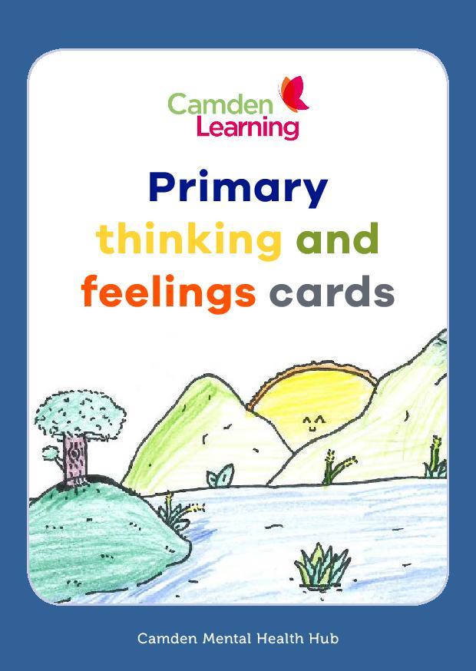
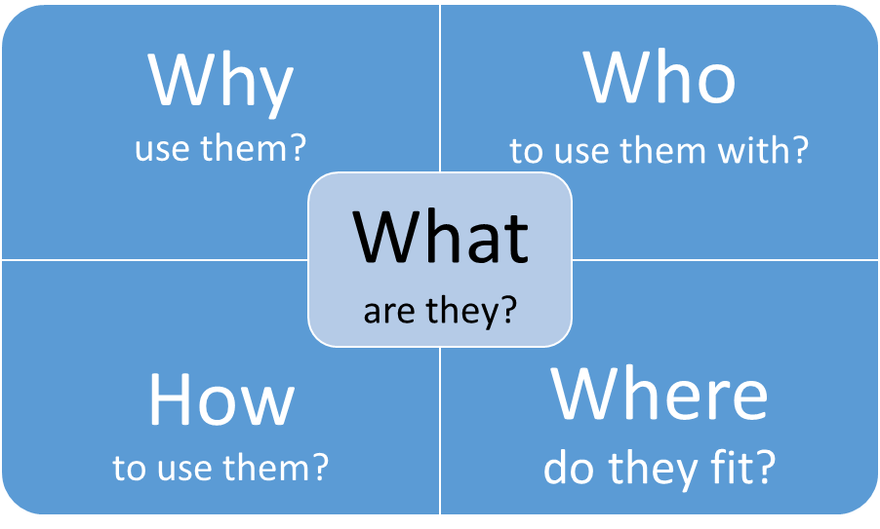

Slide 9

What are they?
developed by Camden teachers for use in primary schools
building on the existing secondary Thinking Cards resource
a resource that can be used to support children in developing their emotional literacy, in order to promote their well-being.
draws on the psychology that informs Cognitive Behavioural Therapy
The cognitive behavioural model demonstrates that there is a link between the way we think, how we feel, our physical sensations and the way we behave. Cognitive Behavioural Therapy has shown how, by changing the way we think and by strategies to influence our physical state we can change our emotional state.

Slide 10

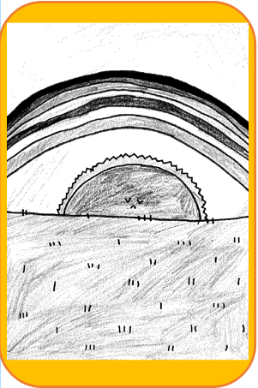
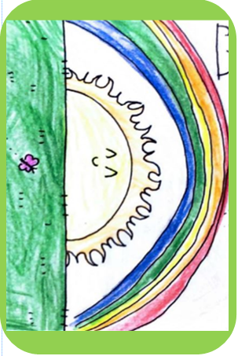
Beginning to trial the cards in schools this year
supporting children in one Year 6 class to identify, track and monitor their feelings
supporting individual KS2 children to set goals about managing their feelings

Slide 11
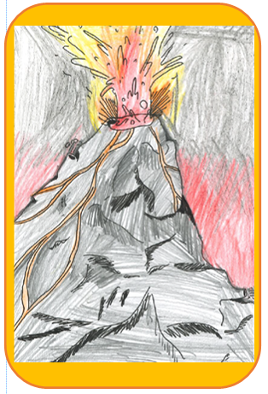
Beginning to trial the cards in schools this year
using the images to start a conversation with younger KS1 children about how they feel
developing animations and presentations to introduce the cards to a whole class or the whole school

Slide 12

Fitting with other approaches
Expand their use to set up whole-class well-being systems, such as “emotion check-ins” | Link into other areas of the curriculum, such as art or work on language development, such as through the Word Aware programme | For all schools, at a universal level, as part of the PSHCE curriculum, for example using the Robson House Outreach Well-Being Programme
For schools adopting a trauma-informed approach, the cards support work at all four levels of the Trauma-Informed Practice in Camden framework and fit within the Regulation tier of the ARC model. | From an SEN perspective, for targeted work for children with identified SEMH needs, for example with individuals where more structured cognitive behavioural approaches are being used (for example Stallard’s Think Good, Feel Good) | Whole school, whole class or targeted intervention groups and individuals

Slide 13

Priorities for the proposed Mental Health Learning Hub 2020/21
Focus on sharing and being responsive to the academic learning about the impact of COVID 19 on mental health issues related to school.
Time and space for school leaders and colleagues to reflect on post-COVID research on mental health
Think about how to formulate a local response to the research

Slide 14

Priorities for the proposed Mental Health Learning Hub 2020/21
Focus on a local response to the range of post COVID-19 mental health resources for schools
- Identify or adapt resources in response to local needs
Create our own resources where there is an identified local need
Work alongside other groups which are sharing post-COVID 19 resources with schools

Slide 15
Priorities for the proposed Mental Health Learning Hub 2020/21
Complete work from 2019/20 Mental Health Hub, where relevant.
School closures interrupted the Hub’s 19/20 work on managing anxiety and developing and trialling resources to support the use of the Primary Thinking Cards. Where we can and where it is still relevant we aim to complete this work next year.

